Slide 1


Homeworking Project Management
& Agility as the New Normal
in a Covid-19 World
Muhammad Abdullah
BSCS F19 A53
Section B

Slide 2

Impact of COVID-19 on projects
Economy of country / world
Reduced project budgets
Projects put on hold or cancelled
Retrenchments
Lockdown restrictions (total shut down/levels/social distance)
Project schedule compression techniques
Quarantine / hospitalization / death

Slide 3

Virtual Project Management
Virtual project management is the process by which one manages projects via remote or virtual teams. When teams are distributed across different time zones, they still need to get assigned tasks and that work must be monitored and tracked to make sure it stays on schedule. As more teams work from home, virtual project management has become our new norm.
Project teams being managed are not in one place, but rather scattered over across the four corners of the world. Not having physical contact with one’s team creates new obstacles that project managers must overcome.
Things are changing and project managers must change with them and take their project management into the digital age

Slide 4
How can virtual project management be applied successful
Establish trust
Define new ways of managing projects
Set up ground rules (check your emails, calls, tasks, social media)
Improve communication – reporting
Track teams performance/deadlines
Manage working from home
Stick to the scheduled meetings (stand-up)
Use technology: tools, services
Use social media
e-Signatures
Create virtual PMO
Manage costs / timesheets
Manage dual reporting

Slide 5

Impact of working from home
reduced absenteeism and turnover
High employee retention – balancing act
Good for bottom line
Attract and access to more talent
Greater productivity

Slide 6
Impact of working from home
Challenges
Building trust
Monitoring progress
Office culture
Slow communication
Disturbances
unstructured

Slide 7

Risk Management
Show stopper
Project recovery plans
Business Case Justification
Project budgets
Human resources
Time / schedule
Project schedule compression
techniques: Crash or Fast Track
Positive risks:
Enhance
Exploit

Slide 8


Is technology the answer?
4IR
Video and teleconferences
Tracking and reporting tools,
Wi-Fi connectivity,
Cloud Computing
Sharing and storage of documents
E-Learning - training portals.

Slide 9
Virtual Meeting Platforms
Advantages
Disadvantages
No time wasted
Enhanced communications
Lessens traveling costs and time
Enhanced efficiency
Spread knowledge
Giving infinite invitations
Different meeting schedules
Easy to use interface
Live recorded meeting
General productivity increases
Home environment not conducive
Less direct interaction
Unstable or no connection
Cost of data
Less human contact
Security - Hacking

Slide 10
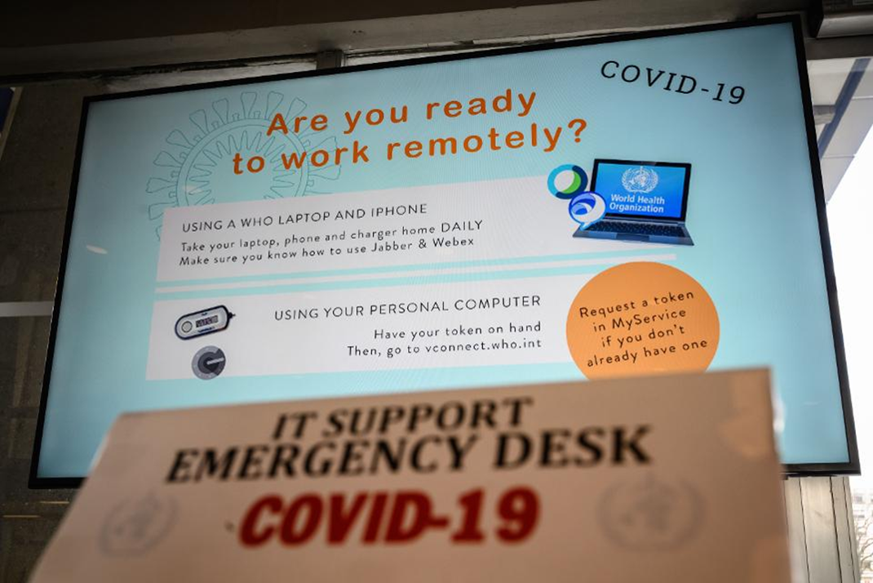
Are you ready for a new normal?

